Slide 1
Senior Capstone
Software Issue & Change Management
Requirements Document
Donald Akujobi
Raymond Lemon
Amber Dawkins
Matthew King
Wayne State University

Slide 2

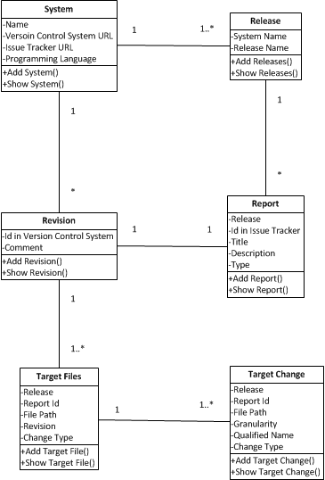

Slide 3

Edited our previous page flow model to give a clearer view of how the website should work
Setup development environments (IntelliJ, Apache Tomcat, MySQL)
Setup Github accounts
Setup TortoiseSVN
Did research for using the Spring framework for the login and functions for pages.

Slide 4

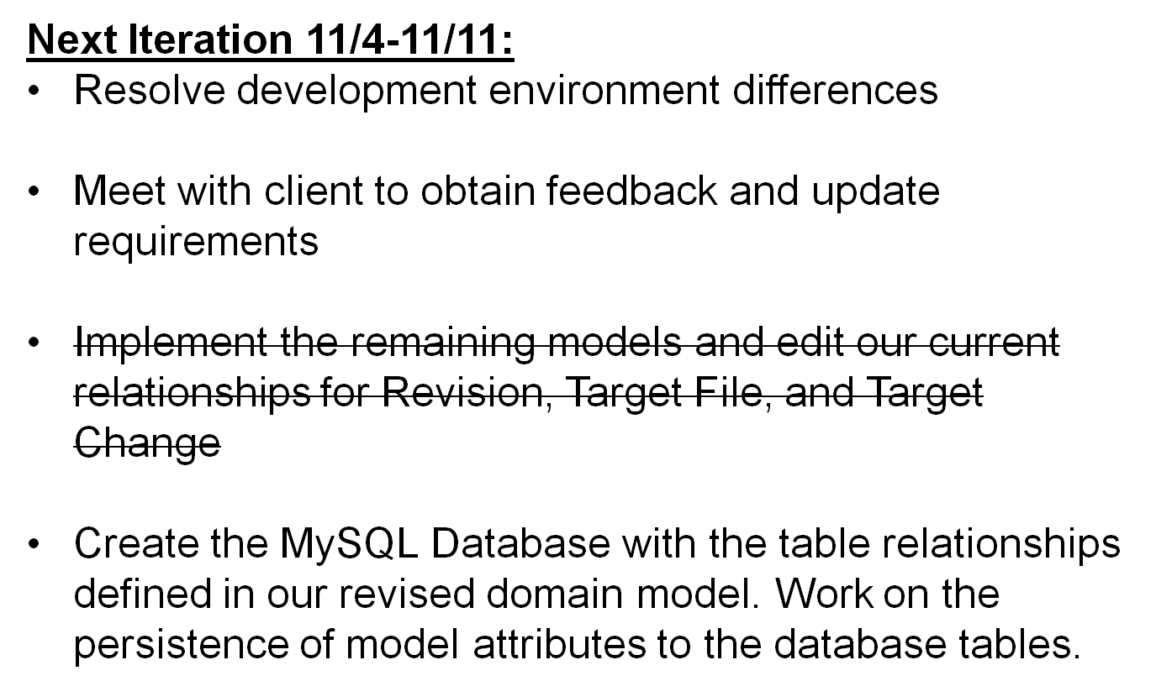

Slide 5

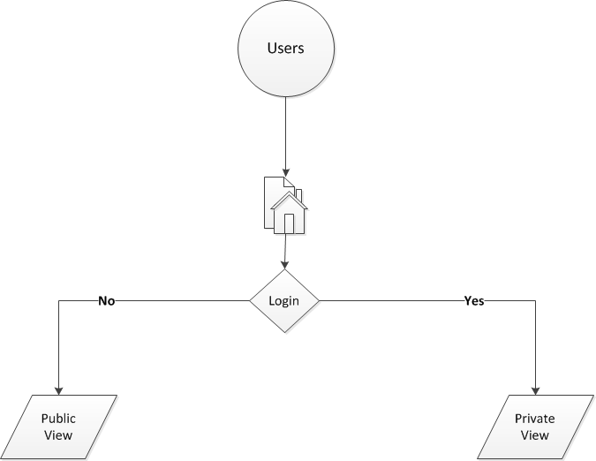

Slide 6

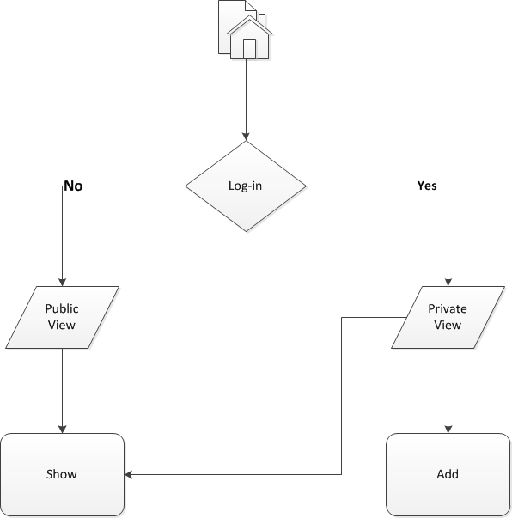

Slide 7
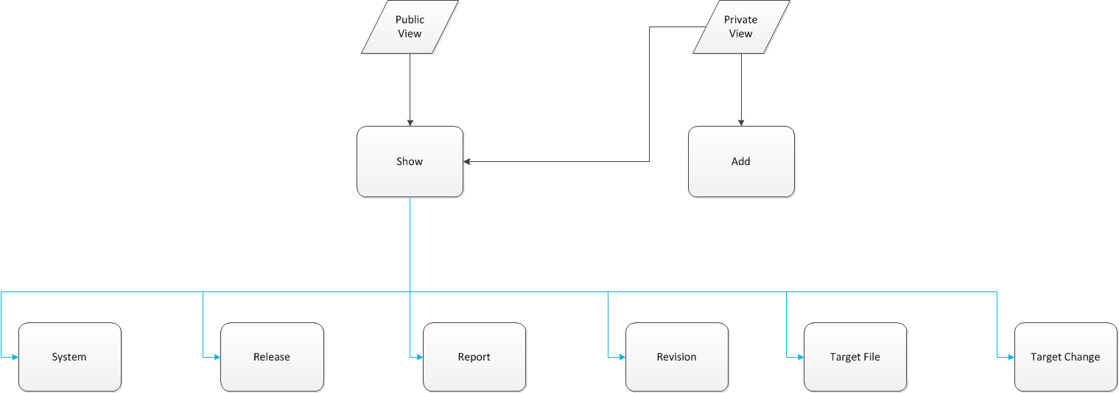

Slide 8
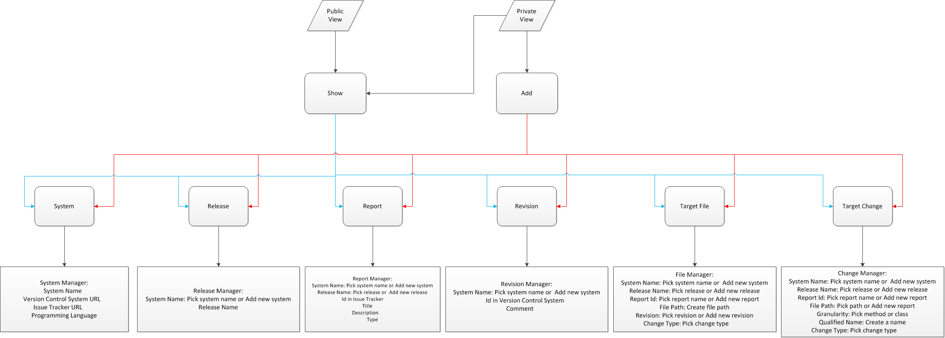

Slide 9
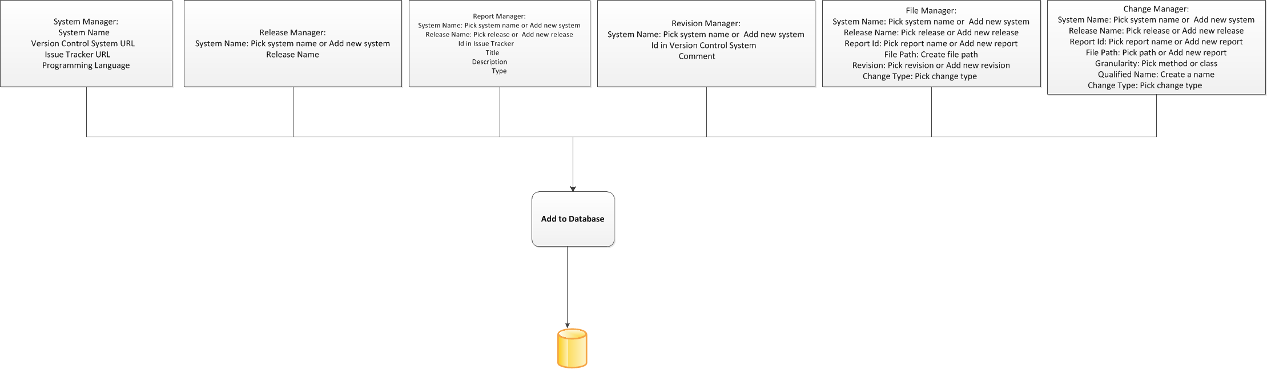

Slide 10
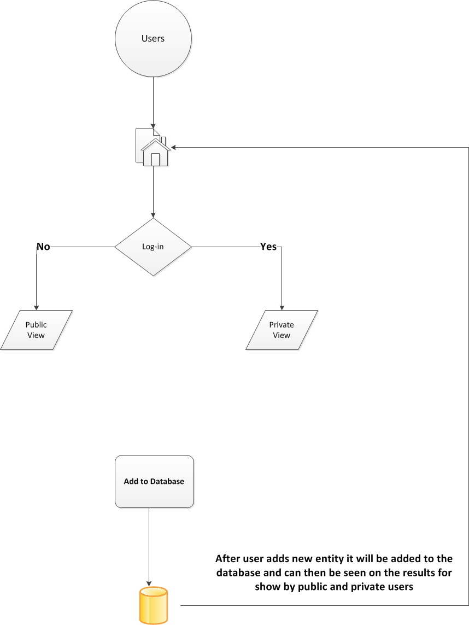

Slide 11
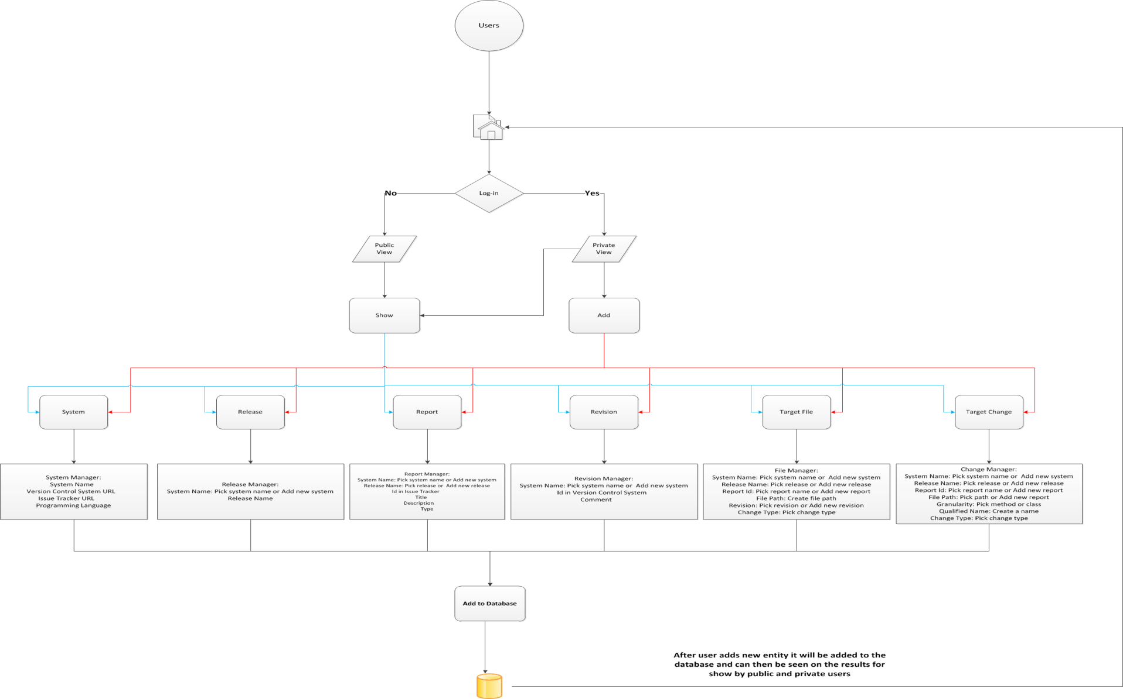

Slide 12

Bootstrap
http://getbootstrap.com/
DesignDocuments/JavaTutorials:
http://www.youtube.com/user/derekbanas/videos?view=1&flow=grid
Spring, Hibernate, Spring MVC:
http://www.youtube.com/user/koushks/videos?view=1&flow=grid
HTML,CSS3,JavaScript:
http://thenewboston.org/tutorials.php

